Slide 1
Detector
Detector
Pin-Hole 1
Pin-Hole 1
LASER Source
LASER Source
Half Mirror
Half Mirror
Pin-Hole 2
Pin-Hole 2
Convex Lens
Convex Lens
Sample
Sample
Scanning
Scanning

Slide 2
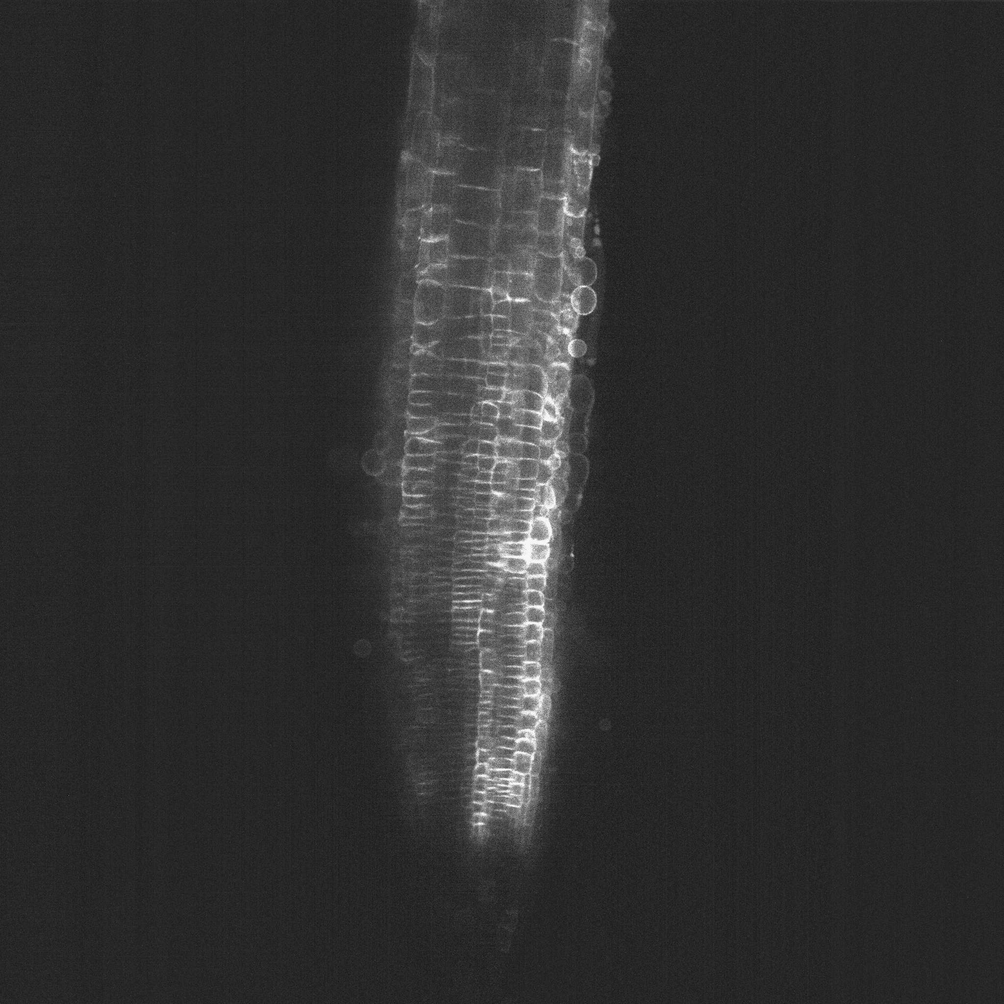







Slide 3
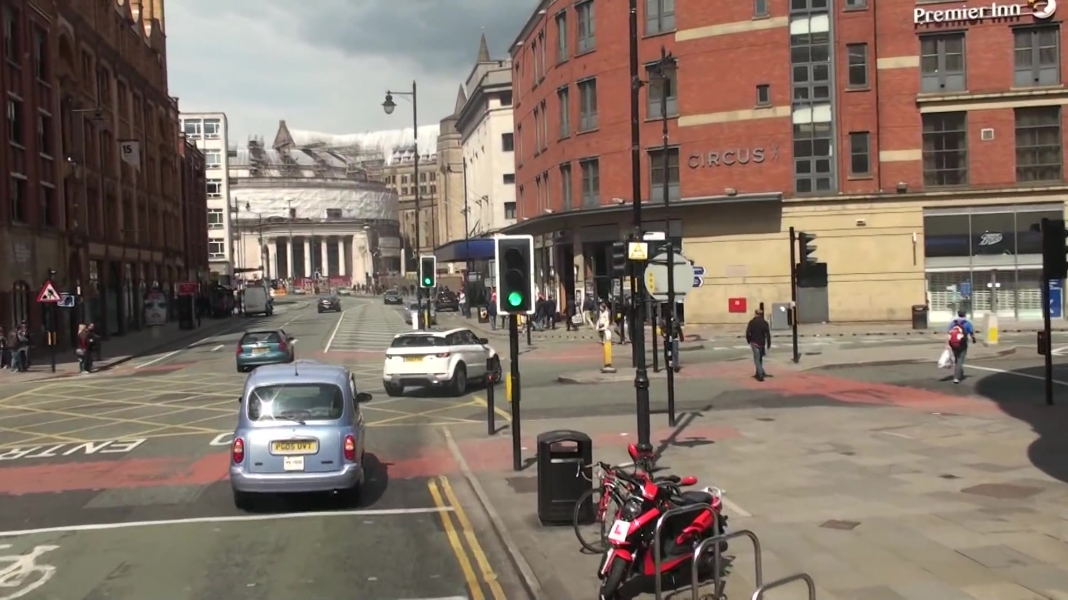


Original image
Segmentation mask

Slide 4
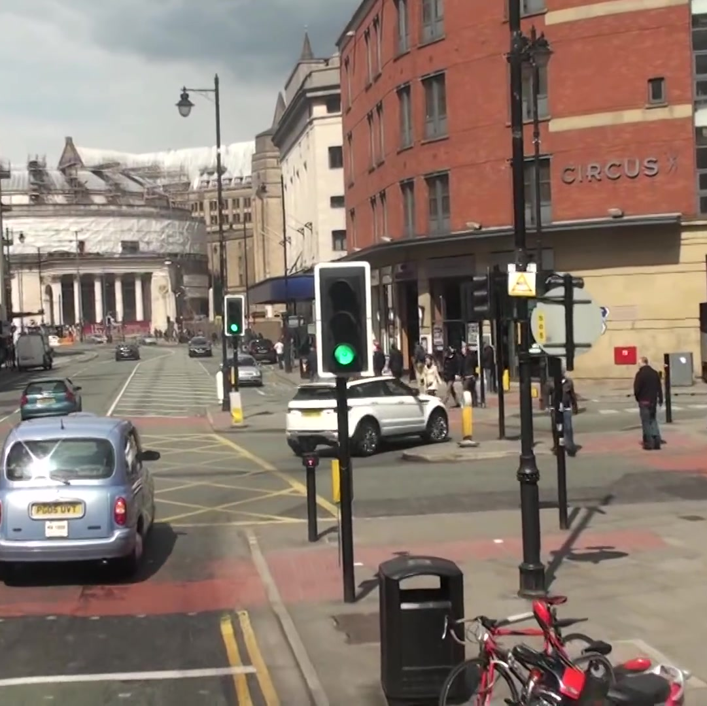
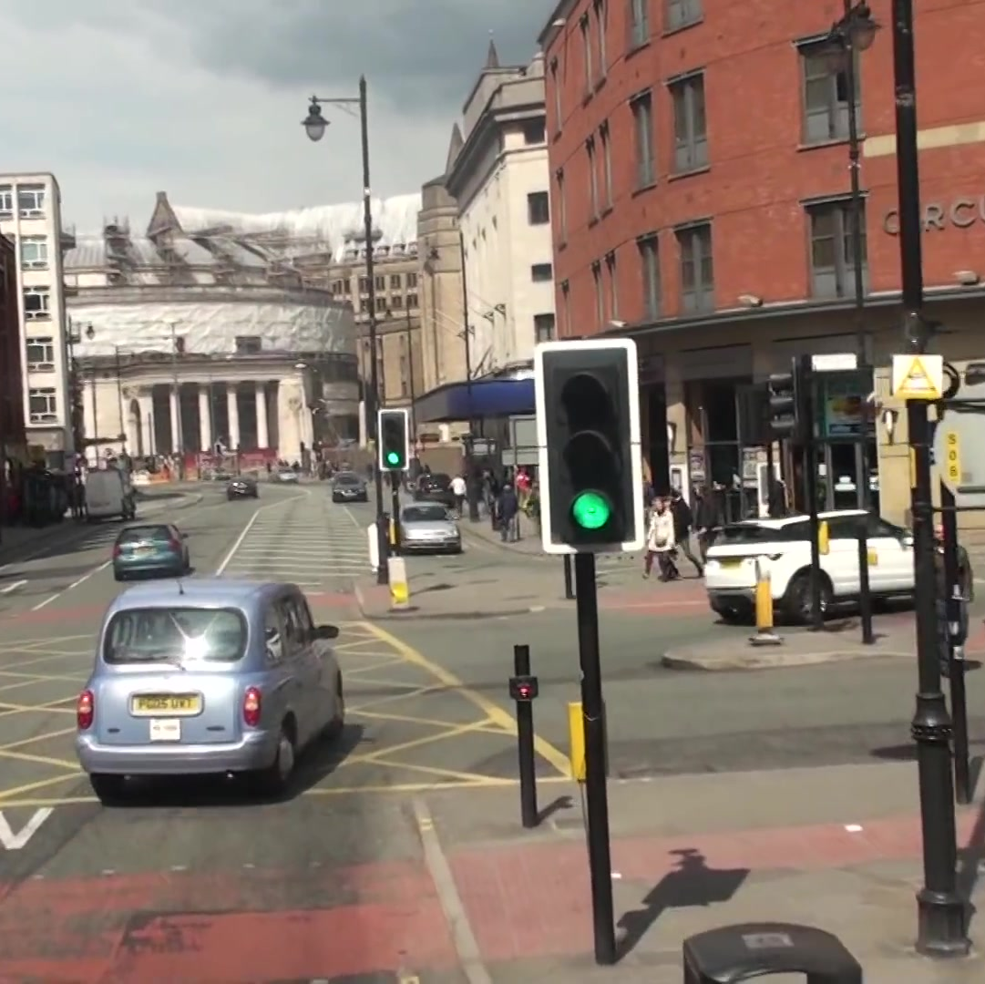
(1) Object Detection
(2) Re-Identification

Slide 5
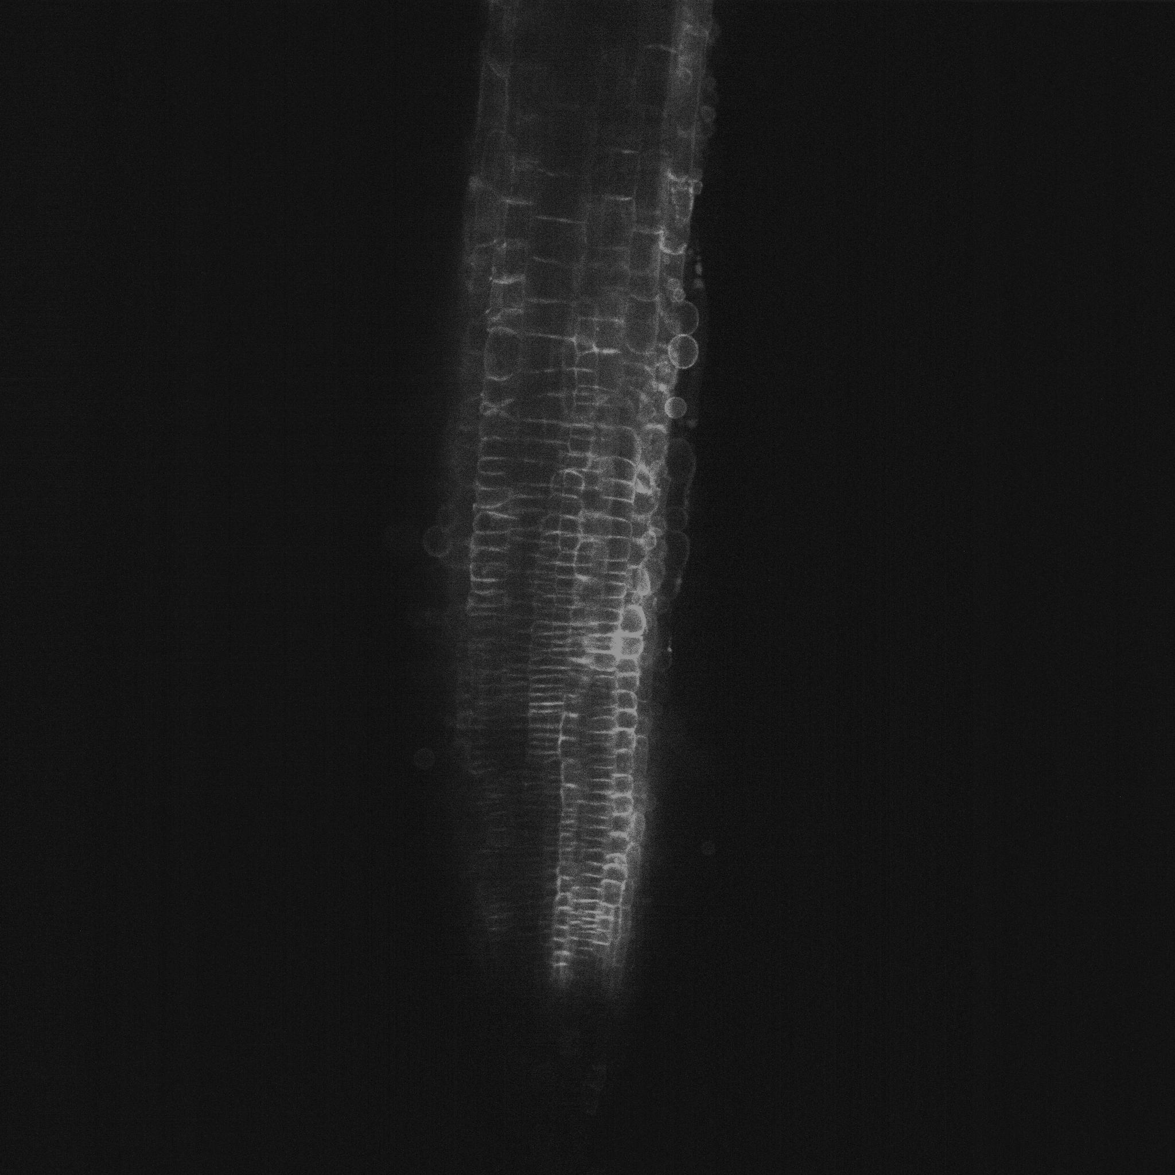
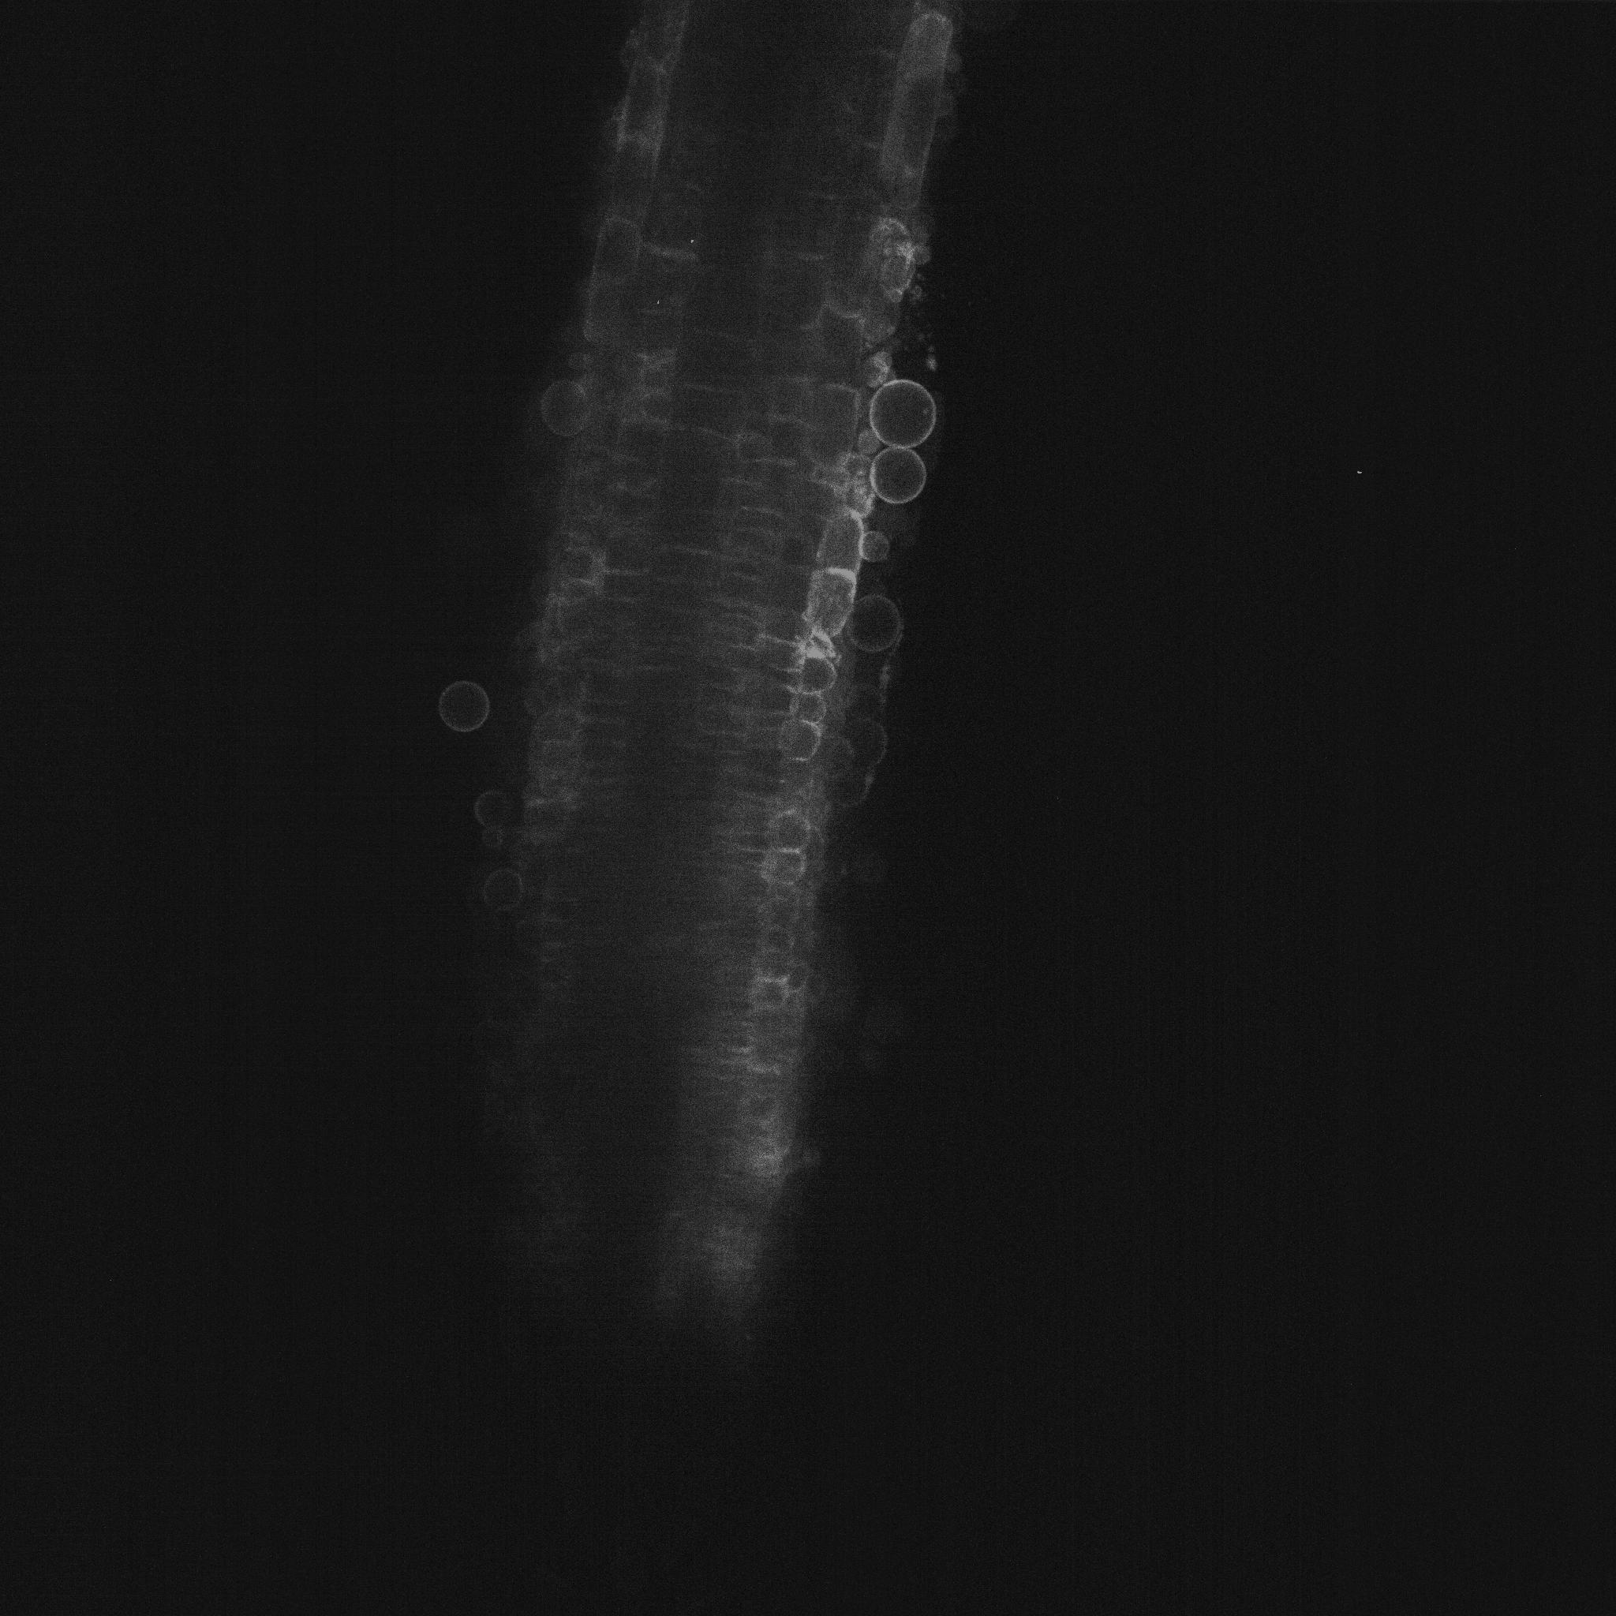


The same individual
Segmentation mask
Tracked positions
Original image
Segmentation mask

Slide 7
SORT with only one slice
With multiple slices
☓ Cannot estimate 3D state variables
◯ 3D state variables can be predicted

Slide 8
1. Predict
2. Matching
3. Update

Slide 10
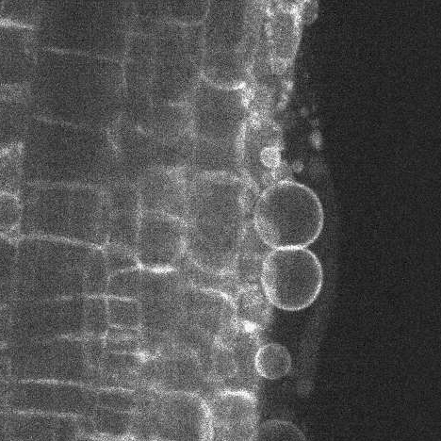
- Detection -
- ID Assignment -
- Estimation -
ID: 1
ID: 4
ID: 5

Slide 11
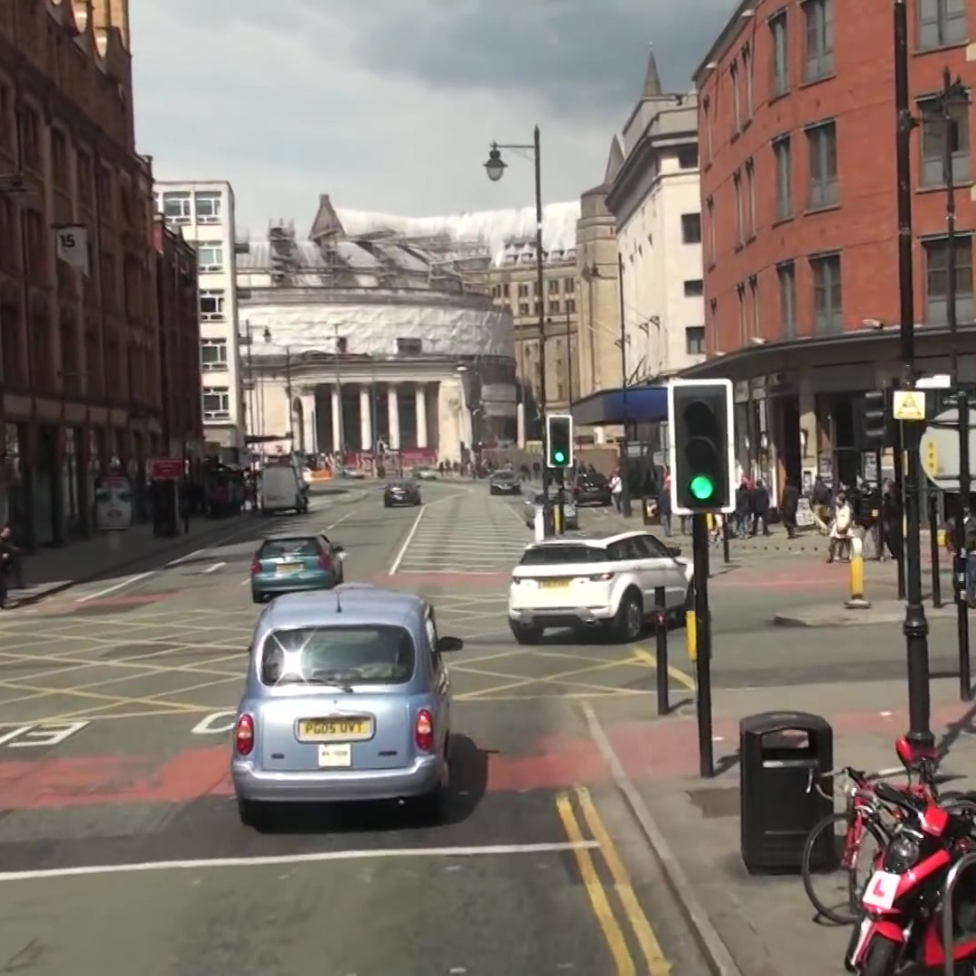
image
Backbone
Head
Non-Maximum
Suppression

Slide 12
1. Pre-Training
1. Fine-Tuning
training
(only red)
training
Large Dataset
Small Dataset
Good Parameters
Replace Parameters

Slide 13
・・・
(1) Object Detection
Object Detector
・・・
・・・
Matching
(2) Re-Identification
Bounding Box Prediction
・・・
(3) State Estimation
Observation Variables
Update State Variables

Slide 14
Good Case
Object is born
Bad Case
Object is born

Slide 15
Time-directional matching
Predicted bounding-boxes
Refer to other slices
Depth-directional matching
(Depth-SORT)
Detected bounding-boxes

Slide 16
Only TP
With FP
With FN

Slide 17
SORT + DepthSORT
SKF + DepthSORT （一部抜粋）
only SKF
only SORT

Slide 18
(a)
(b)
(c)
(d)

Slide 19
With DepthSORT
Without DepthSORT

Slide 20
With DepthSORT
Without DepthSORT

Slide 21
Without DepthSORT
With DepthSORT

Slide 26
Size n
Size s
Size m
Size b
Size l
Size x

Slide 27
Model Size N
Model Size S
Model Size M
Model Size B
Model Size L
Model Size X

Slide 28


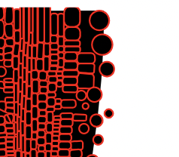
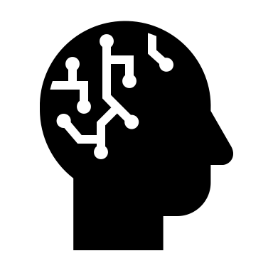
Save microscopic images
Collect with robot one by one
AI
Retain original position
Recognize current position

Slide 29
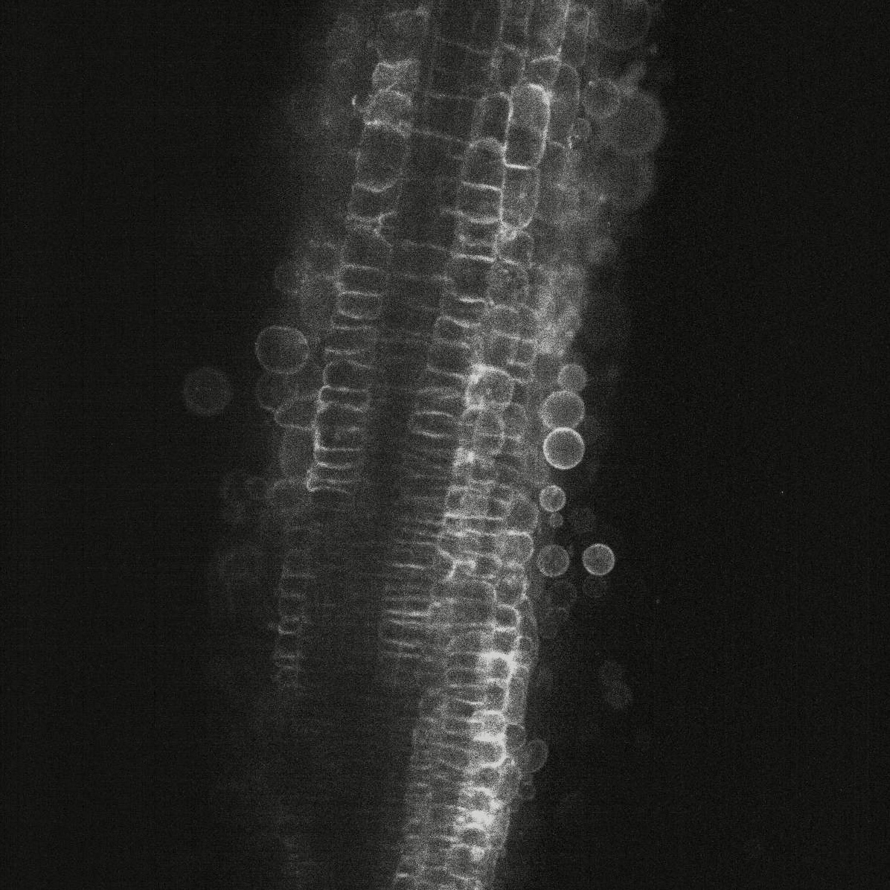

Slide 37
ここからあたらしいやつ

Slide 42
ここからさらにあたらしいやつ

Slide 47
ここからスライド

Slide 49
See RNA
A
U
U
C
G
A
A
C
C
U
G
U
A
G
G
G
U
A
C
A
C
U
See RNA
What RNA patterns caused Re-Programming ?

Slide 50

顕微鏡画像を取得
（東大佐藤研 + 東大新井研）
ロボットで一つずつ分取
（東大新井研 + 名大星野研）
AI
遊離前の位置を特定
（名大竹内研 + 名大森研）
リアルタイムで遊離細胞の位置を特定
（名大竹内研）

Slide 51


Save microscopic images
(Sato Lab. @NU and Arai Lab. @UT)
Collect with robot one by one
(Hoshi Lab. @NU Arai Lab. @UT)
AI
Preserve cell address
(Mori Lab. and Takeuchi Lab. @NU)
Recognize current position
(Takeuchi Lab. @NU)

Slide 52
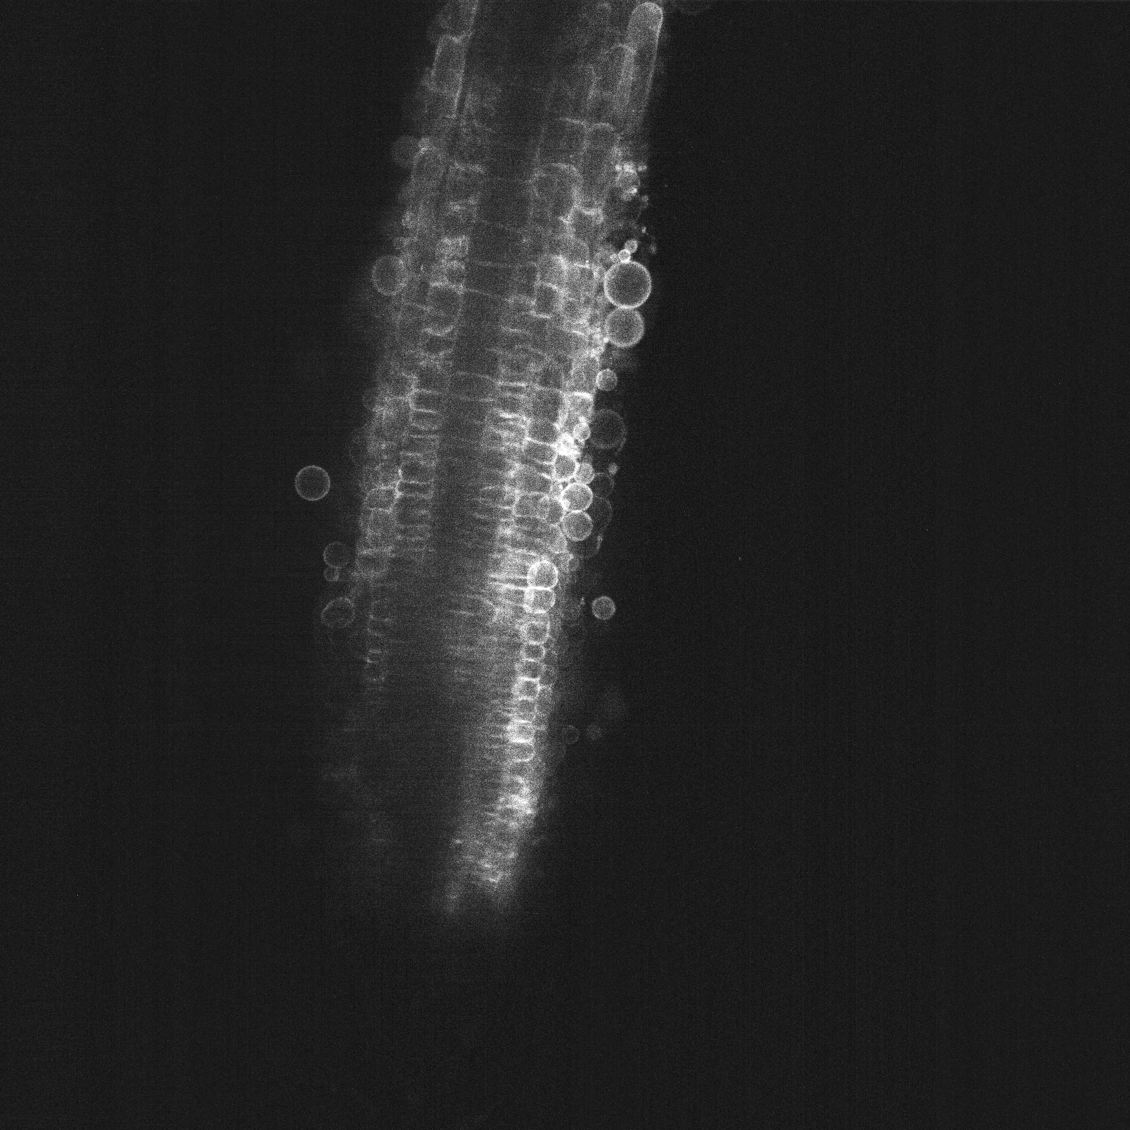
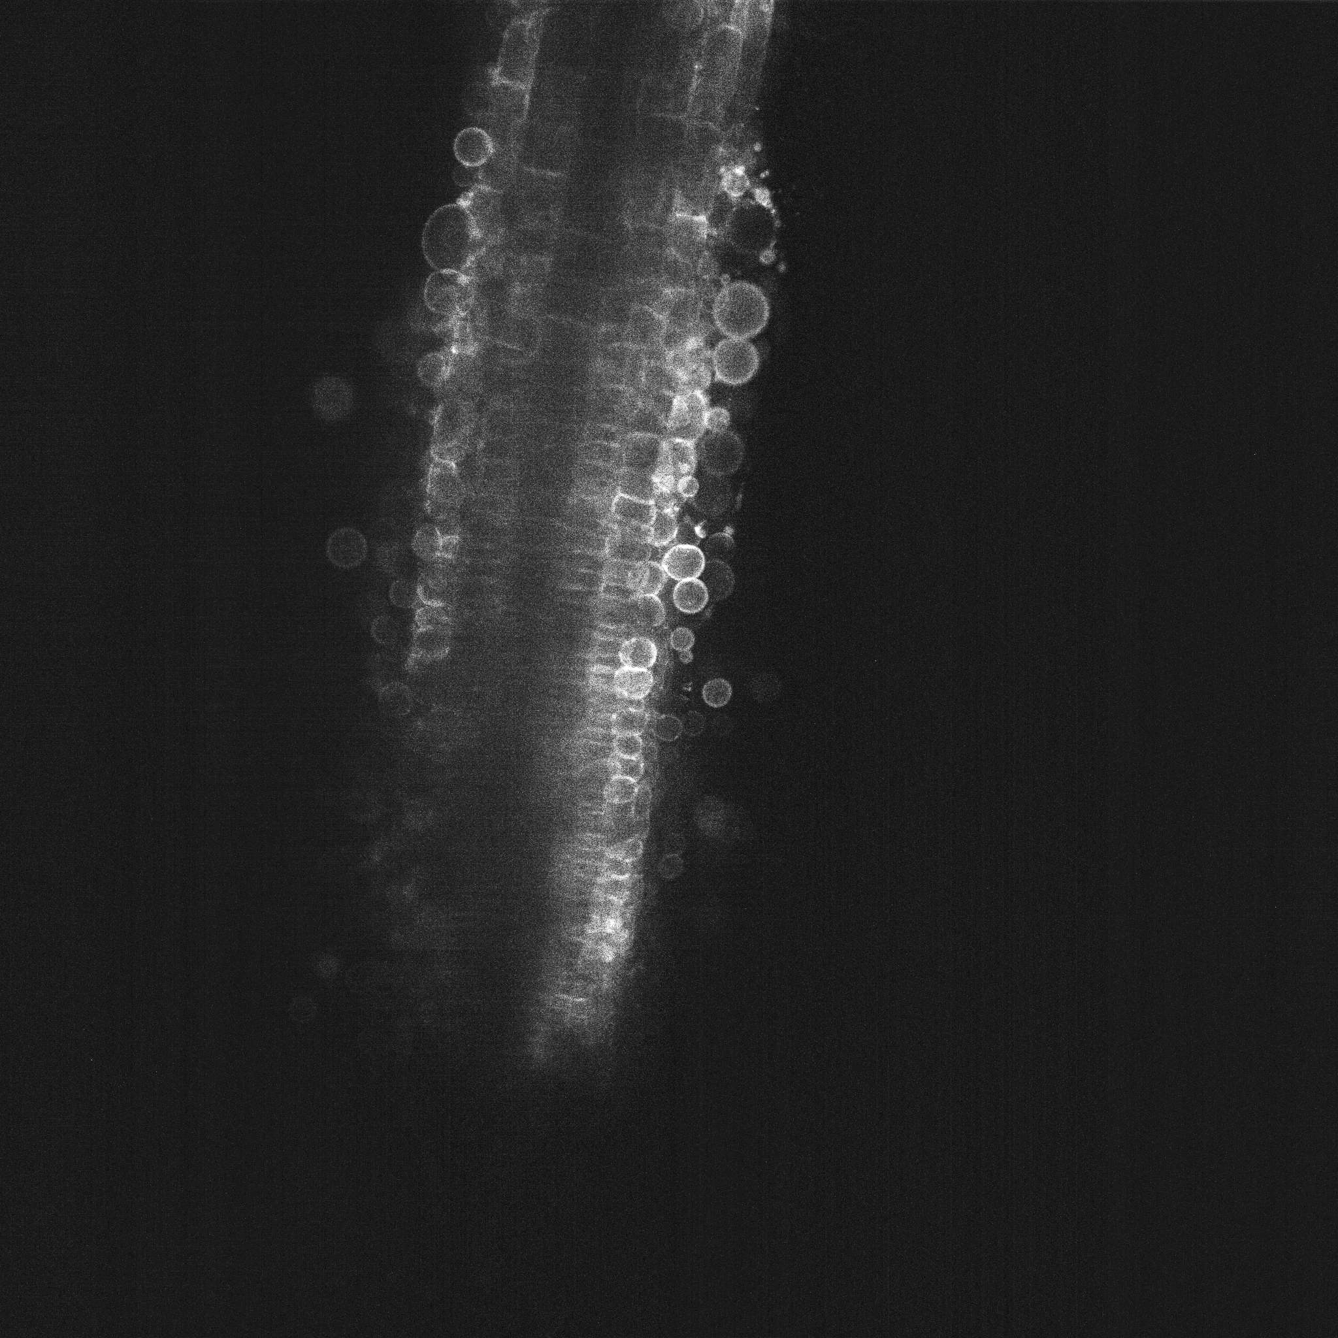
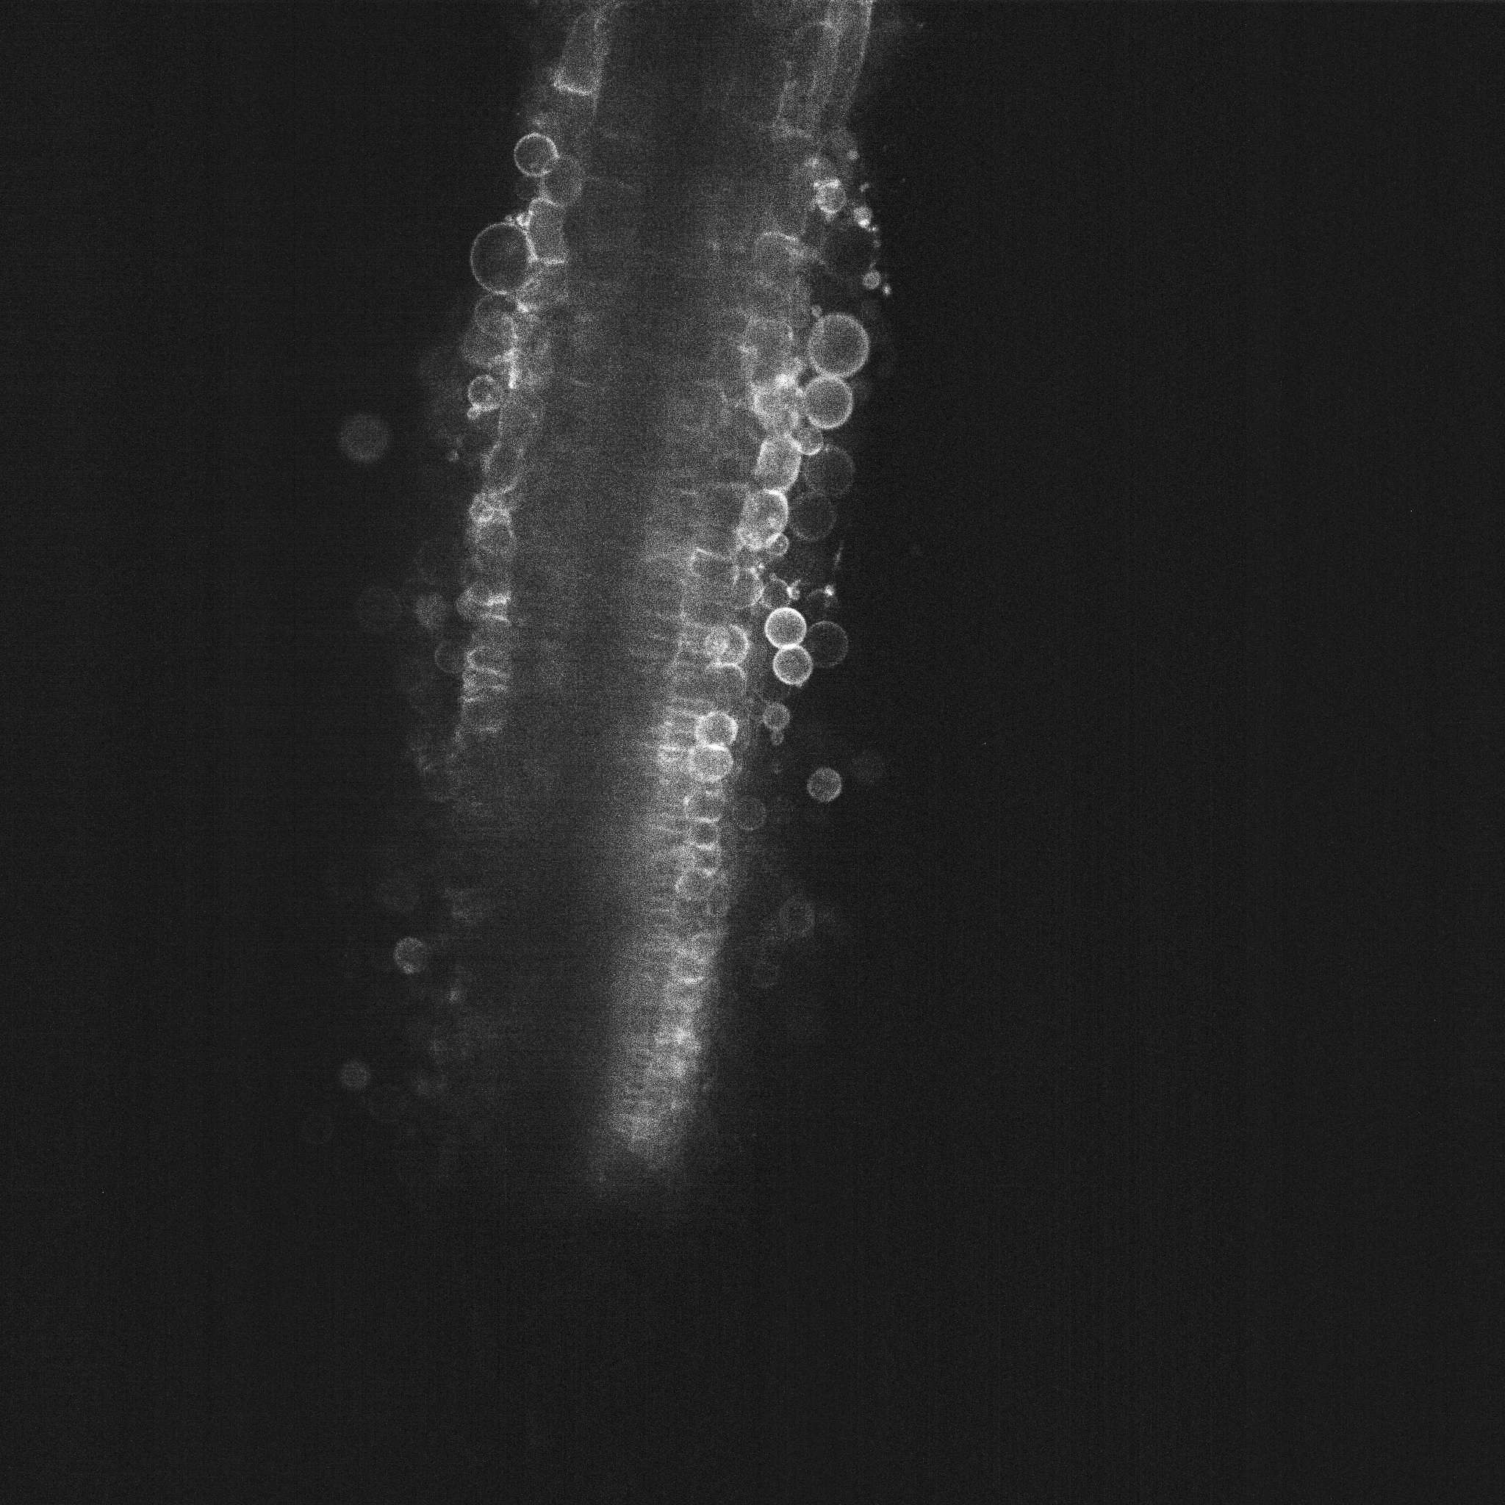
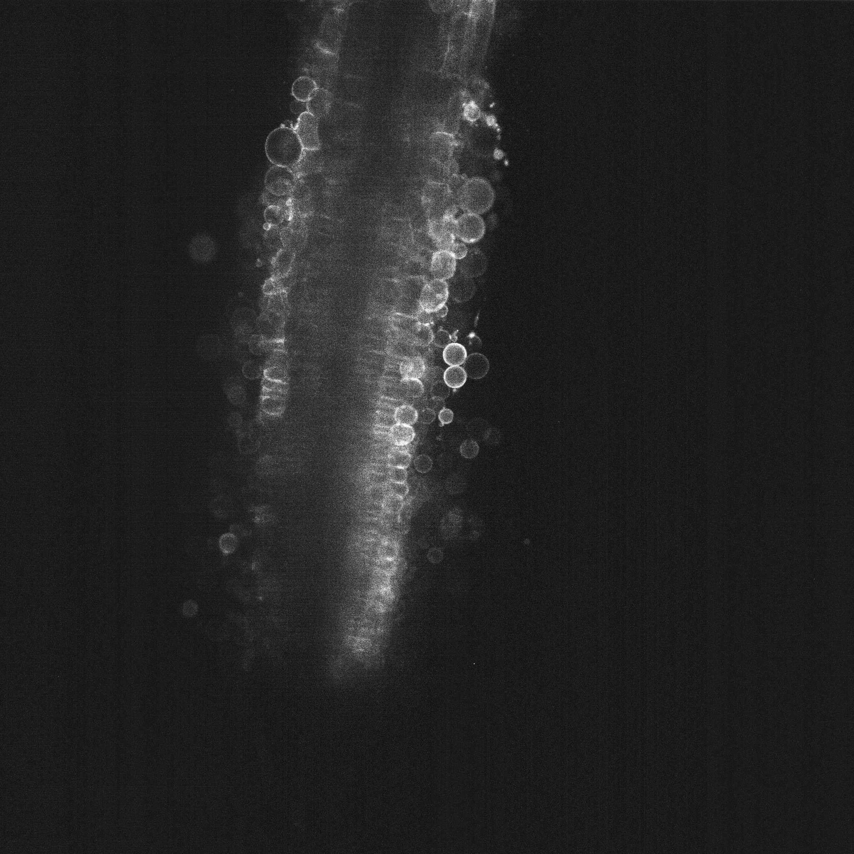
Time 1
Time 2
Time 3
Time 4
To robot: Current positions
Tracking
Tracking
Tracking
To analysis: Each address

Slide 53

20 sec.
20 sec.
Time 1
Time 2
Time 3
Confocal Microscope
20 slices
20 slices
20 slices

Slide 54
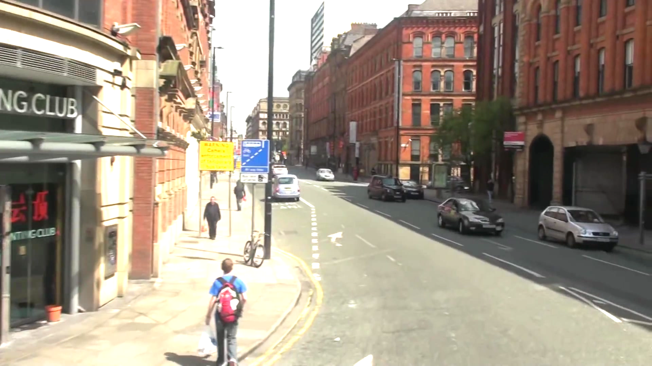
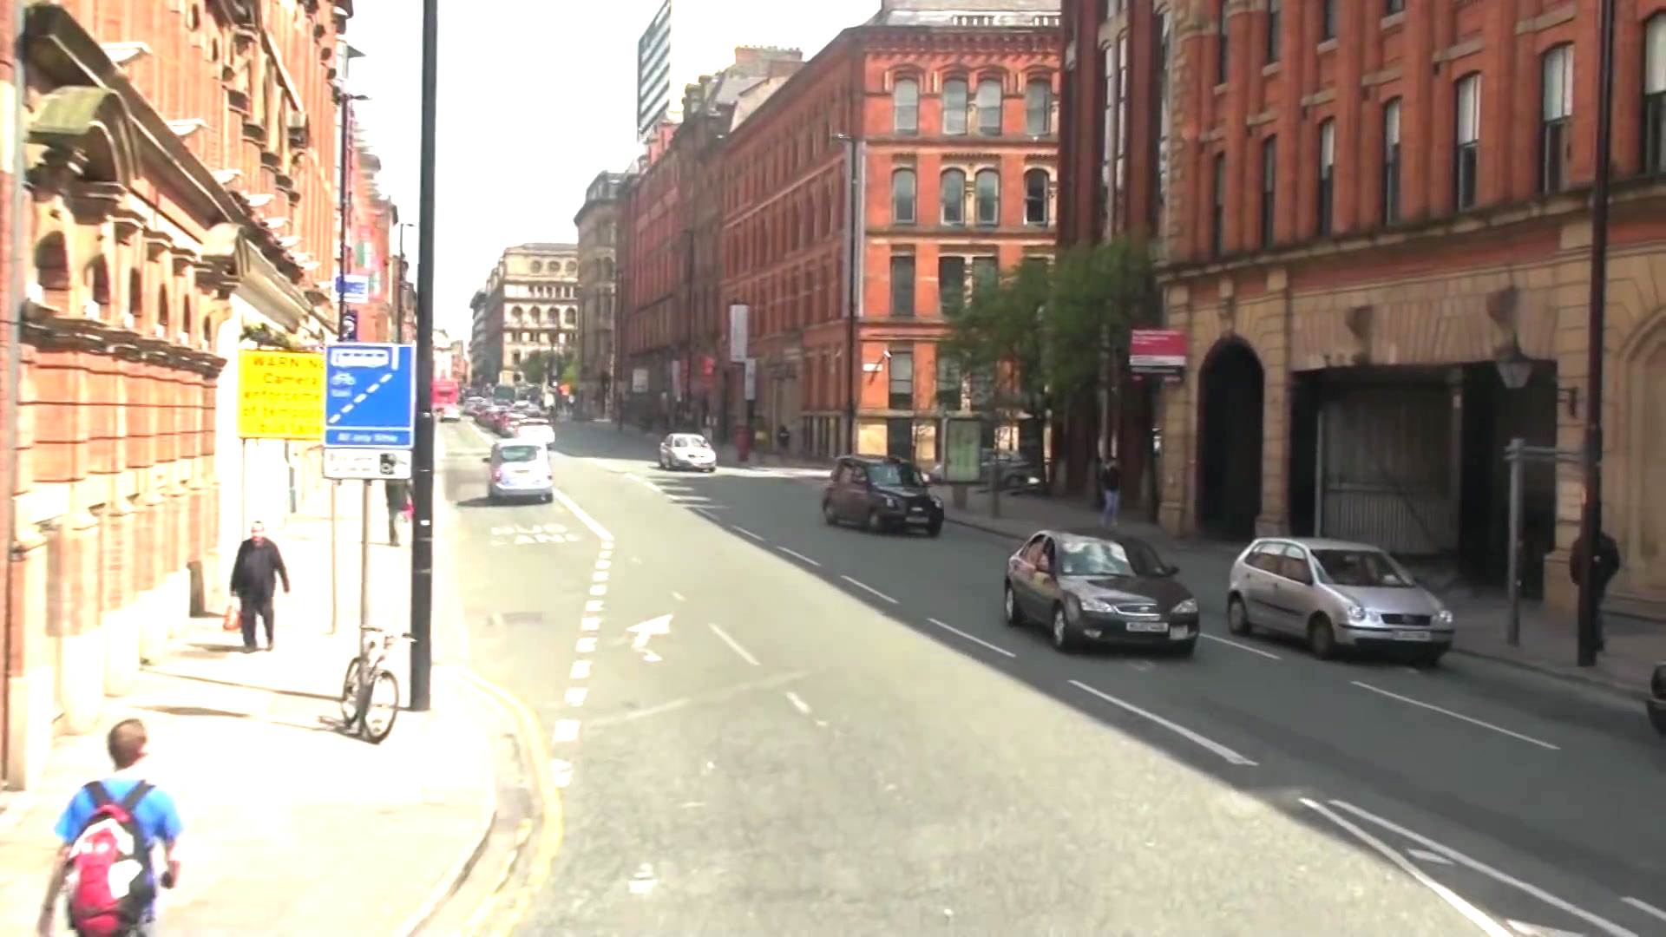
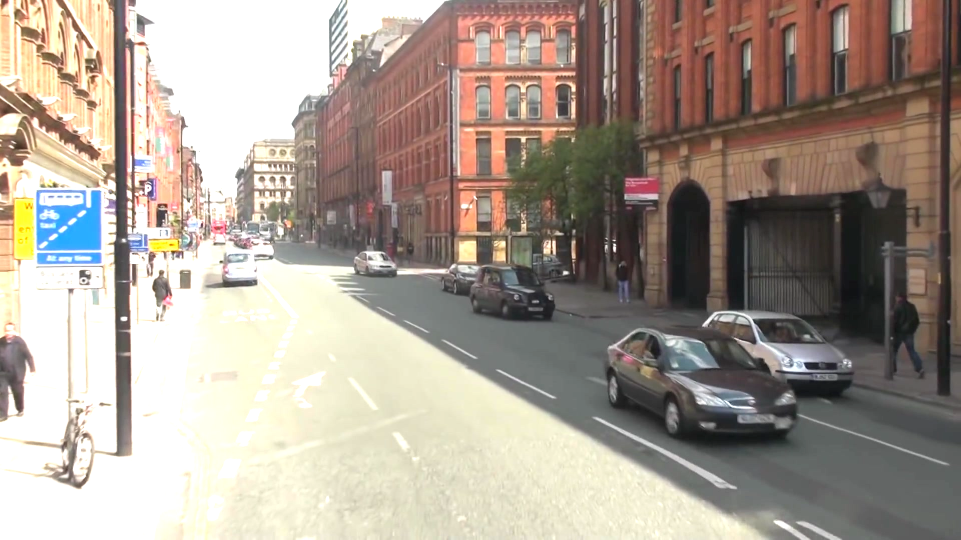
Time 1
Time 2
Time 3

Slide 60
- Detection -
- ID Assignment -
- Estimation -

Slide 61
Refer to Past b-boxes (omitted)
Depth directional tracking
(Depth-SORT)
Sliced images and b-boxes

Slide 63
Time-directional matching
Predicted bounding-boxes
Refer to other slices
Depth-directional matching
(Depth-SORT)
Detected bounding-boxes

Slide 64



Estimation by Kalman Filter
Observation Variables
State Variables

Slide 65
position:
velocity:
Estimation by Kalman Filter
consists of multiple
radius:
Observation Variables
State Variables

Slide 66
Object Detector
Depth directional tracking
(Depth-SORT)
Sliced images
from Confocal Microscope
Refer to Past Tracks and IDs
Observation Sequences
Estimate and Predict by Kalman Filter
(Slice Kalman Filter)
State Variables on 3D-Space

Slide 67
IoU = 0.1
IoU = 0.9

Slide 68
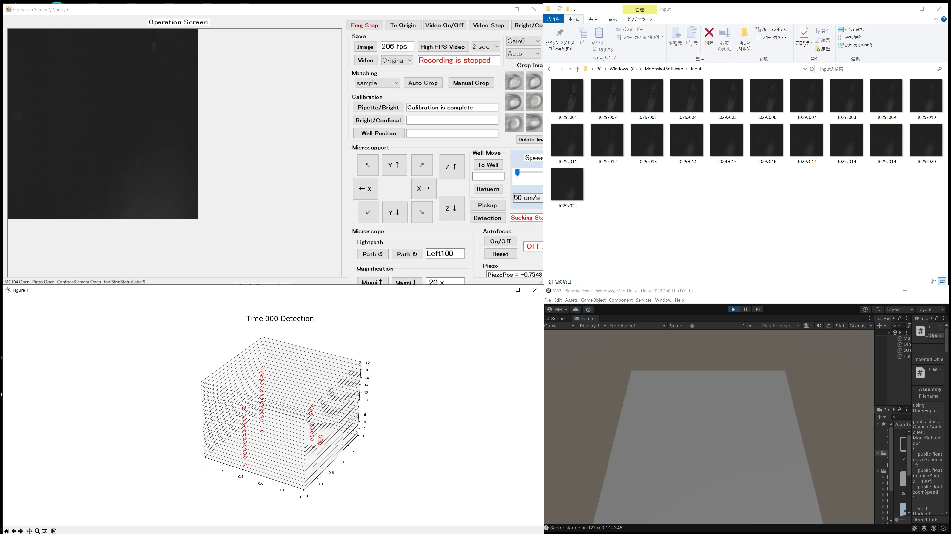
21 Confocal Images
Detected Bounding-Boxes

Slide 69
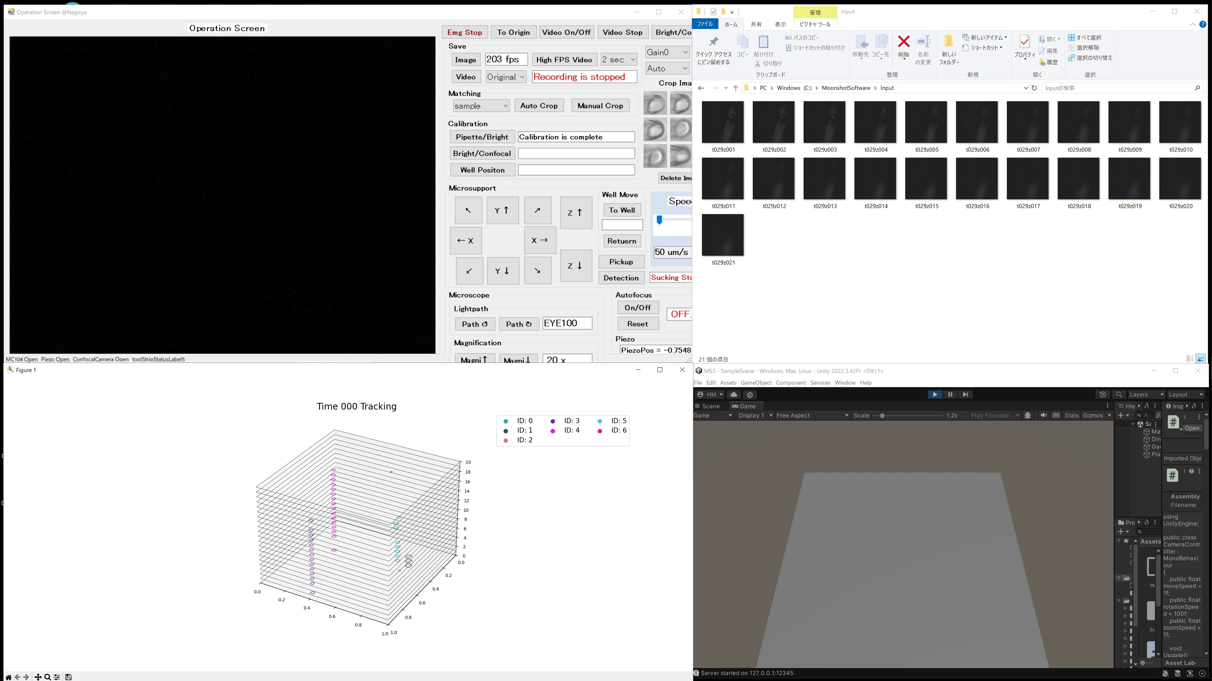
Re-Identified

Slide 70
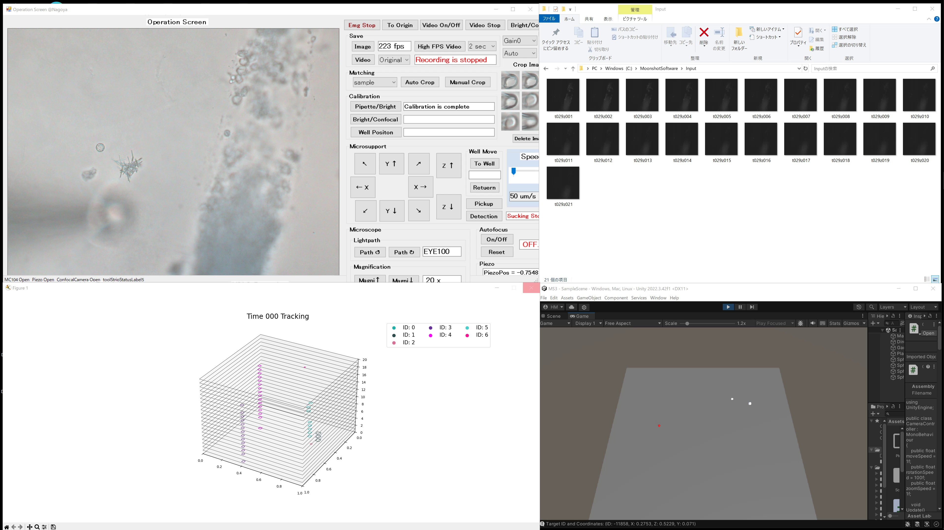
Re-Identified
3D Positions and Target

Slide 71
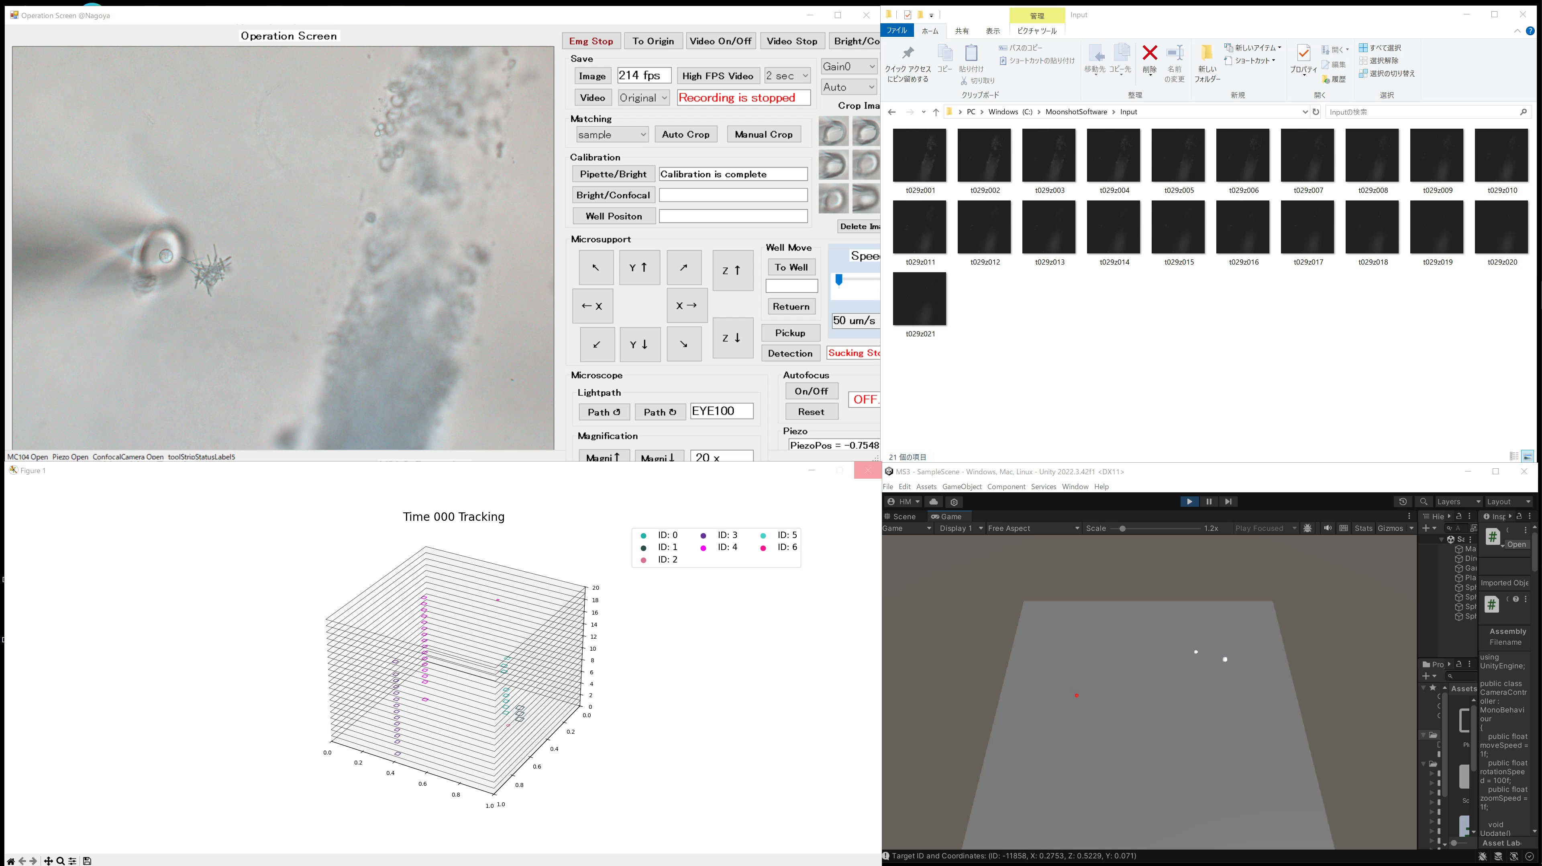
Move and Pickup

Slide 72
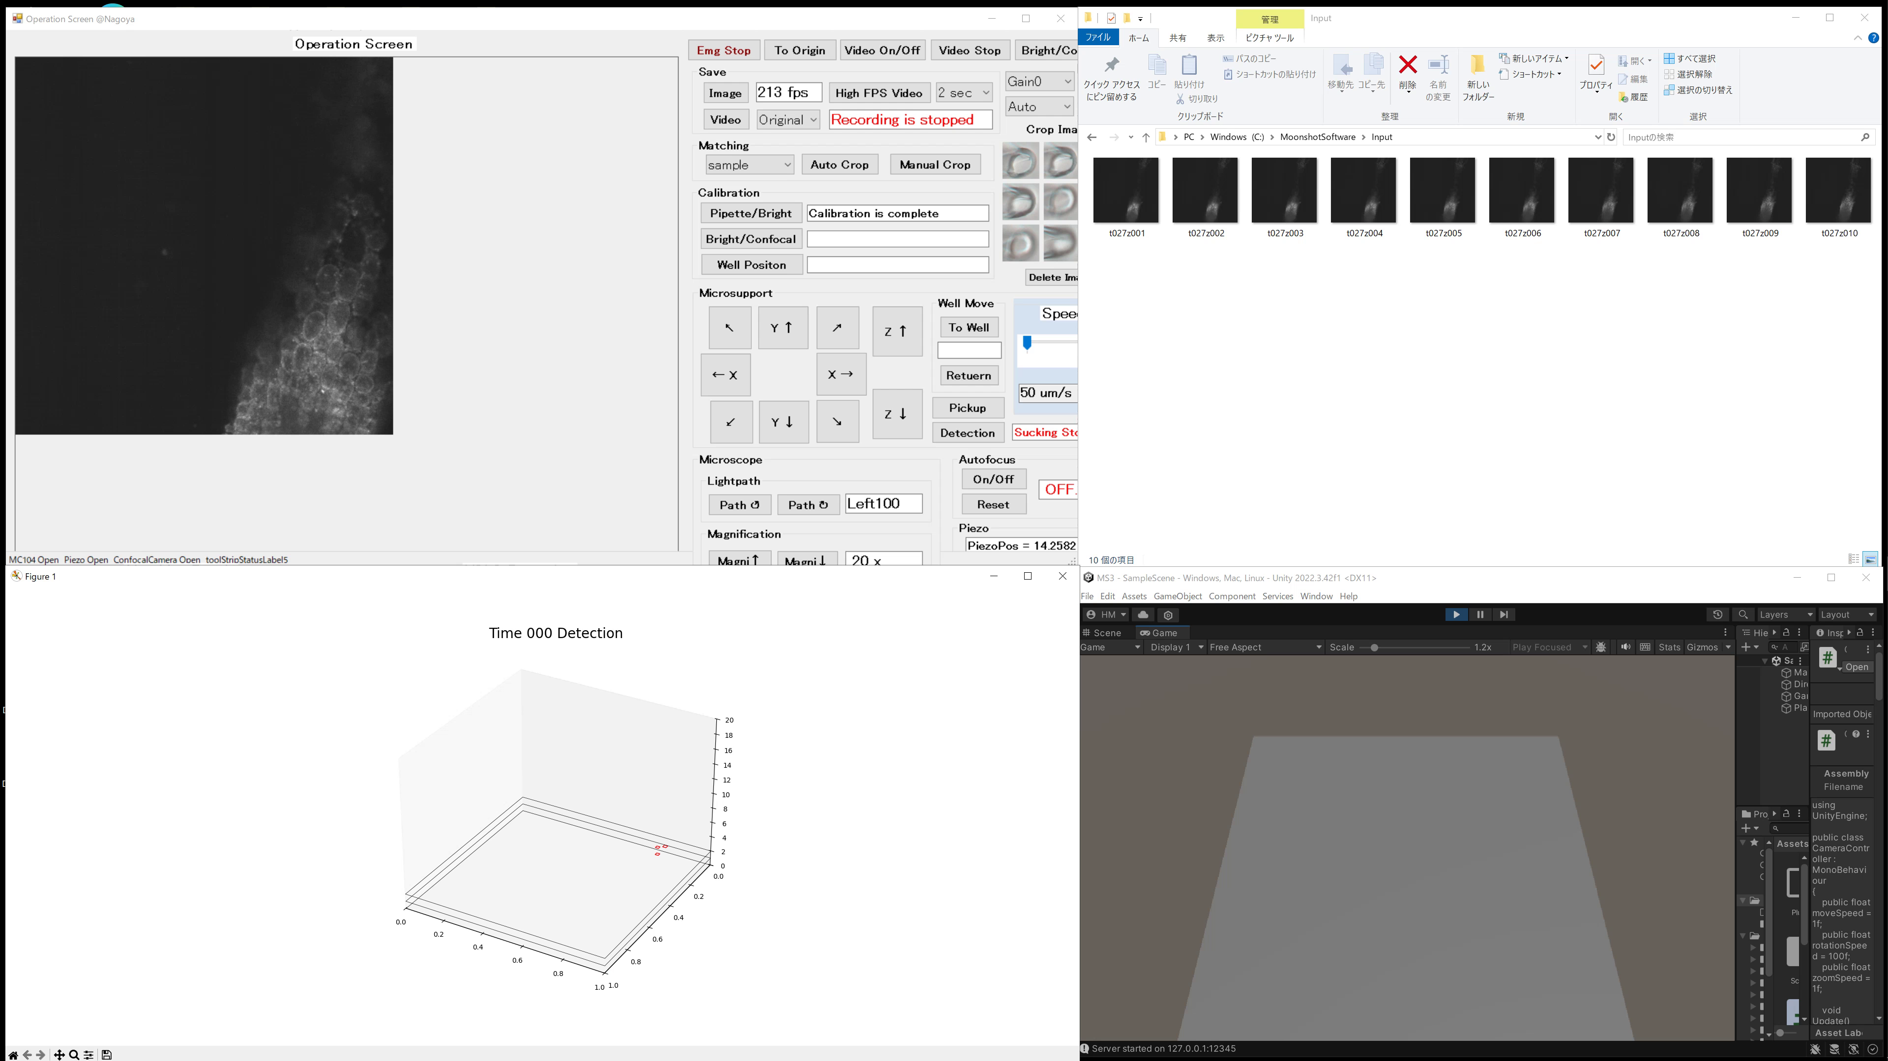
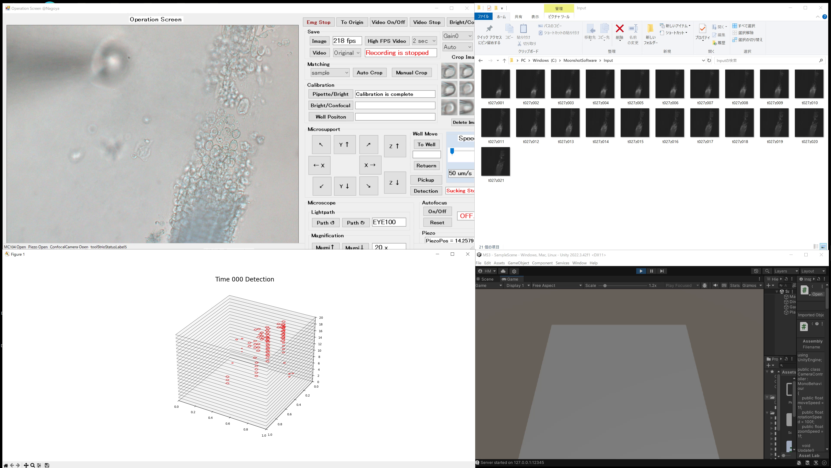

Slide 73
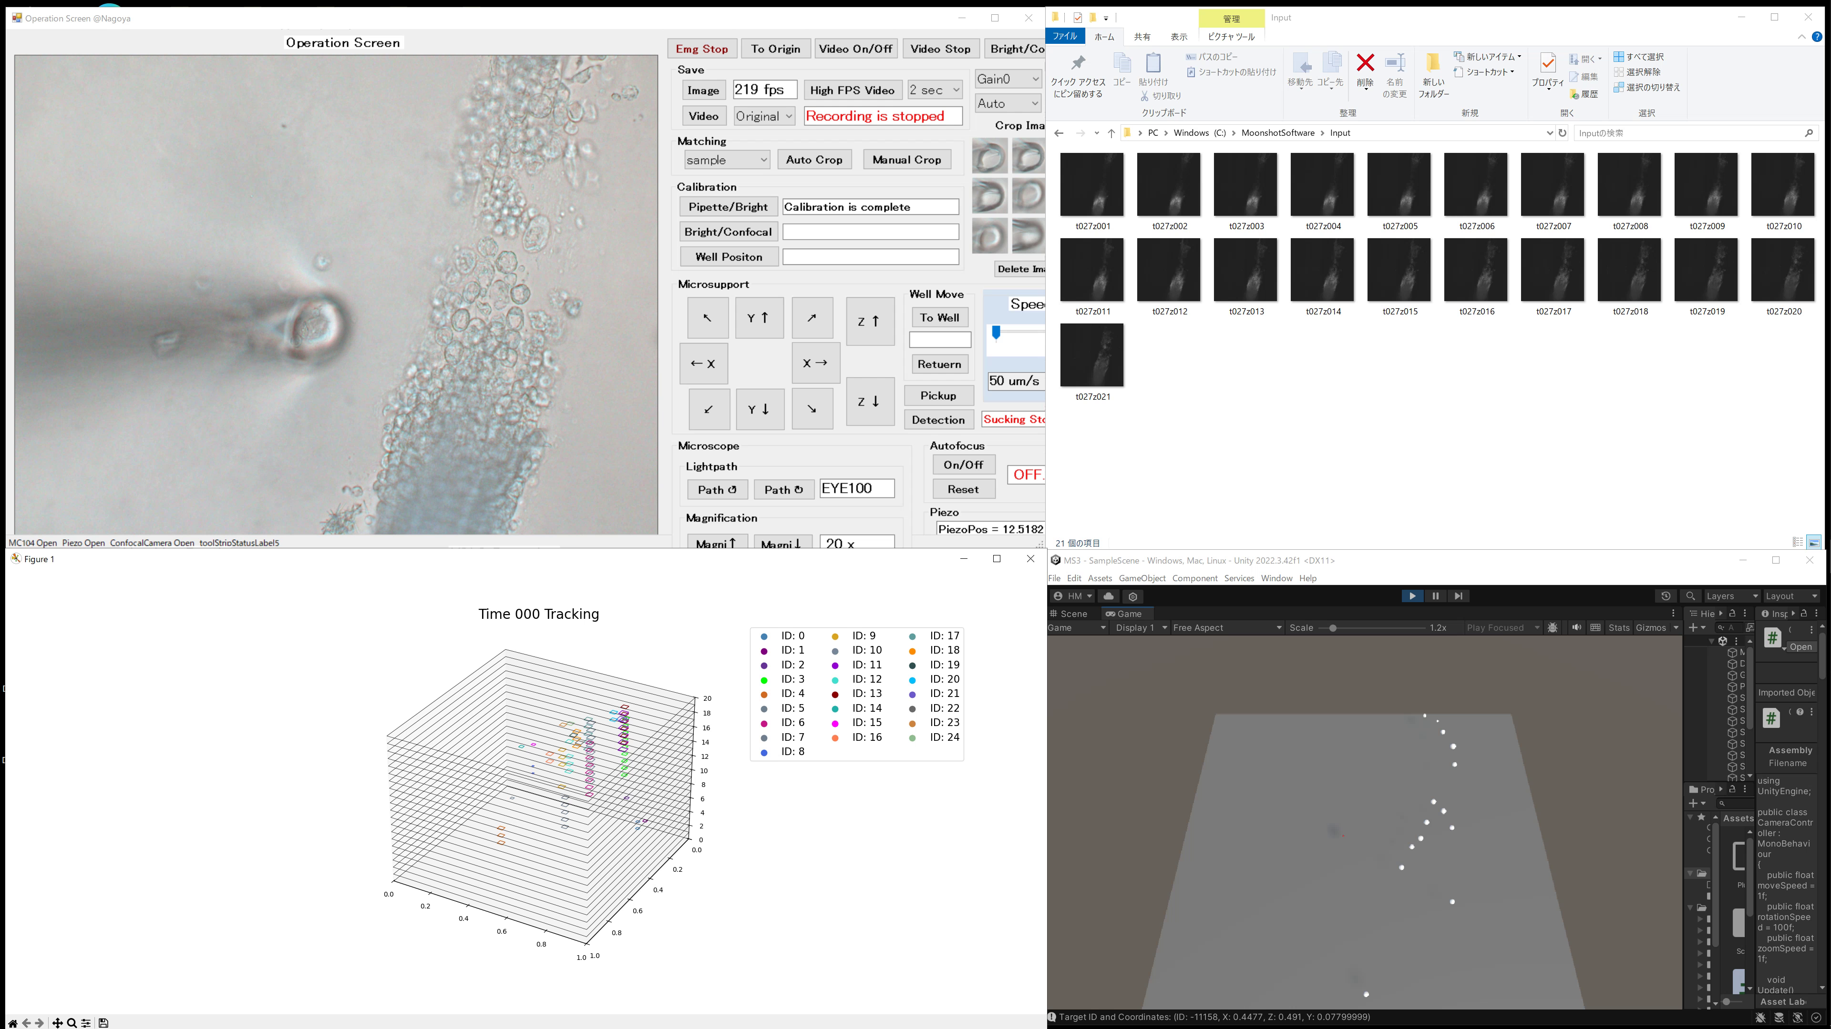
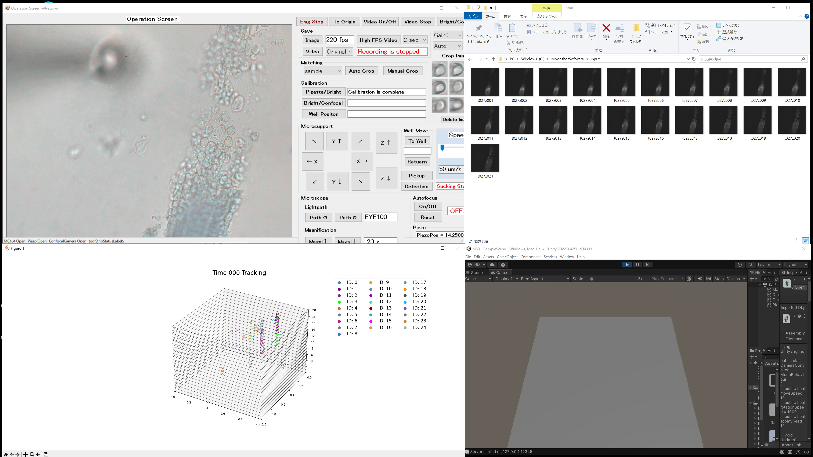


Slide 75
Confocal Images

Slide 76
Detected Bounding-Boxes

Slide 77
Re-Identified Bounding-Boxes

Slide 78
Target
Estimated 3D-Positions

Slide 79
Move and Pickup

